Slide 1
Self Study Project
-Zachary Nash

Slide 2
Finding the Question
What are my routines?
What can I reasonably collect Data on?
Is the study worthwhile?

Slide 3
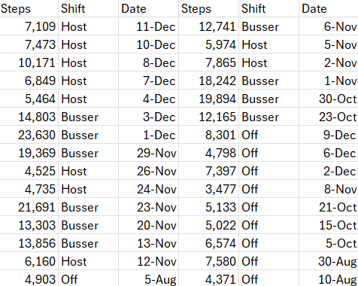
Am I any more active when hosting as opposed to just not working?

Slide 4
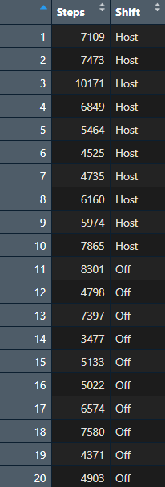

Data
Collection
20 Observations
Variables:
Host Shift? No Shift?
Steps Taken?
Health App

Slide 5
Hypothesis Testing
Claim: the mean number of steps taken on days when I work as a restaurant host is greater than the mean number of steps taken on days when I do not work altogether.
Variables:
Dependent – Step Count
Independent – Did I host or have day off

Slide 6
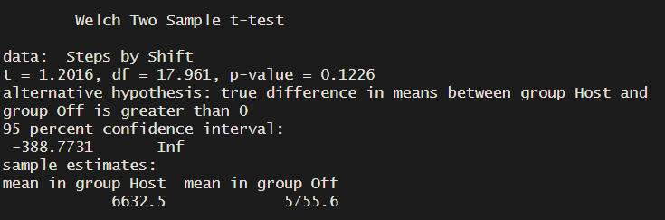
Hypothesis Testing
Step 1:
Step 2: Test Selection
Because we are dealing with means we use a 2 Sample T-Test
Step 3:
T = 1.2016
P = 0.1226
Step 4:
Using a significance level of 0.05, we reject the null hypothesis

Slide 7
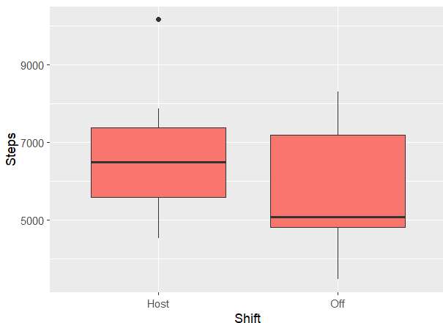
Conclusion
Since the p-value ended up being .1226, greater than 0.05, we reject the null hypothesis. There is not significant evidence to back the claim that the mean number of steps taken on days when I work as a restaurant host is greater than the mean number of steps taken on days when I do not work altogether.

